Slide 1

Classifying Heart Disease Symptoms
Rafael Garcia, Fernando Muñoz

Slide 2
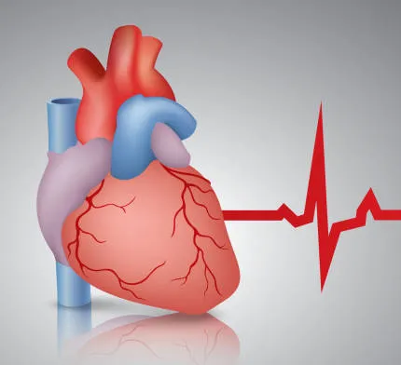
Problem
Many factors involving heart disease
Difficult and time consuming task for doctor’s, especially inexperienced ones.
We want to help simplify their tasks using a machine learning model.
The use of a model presents issues in rural communities:
Lack of sufficiently powerful hardware
Lack of medical equipment to do all tests.
How we want to tackle it:
Provide a model as lightweight as possible
Remove features to the minimum required
Provide visual aid for doctors to advise their patients based on their situation

Slide 3
Data
Our dataset:
https://www.kaggle.com/datasets/johnsmith88/heart-disease-dataset/data
Age | Sex | Chest Pain Type | Resting BP | Serum Cholesterol | Fasting Blood Sugar > 120 mg/dL | Resting Electrocardio- graphic Results | Maximum Heart Rate
- | - 0 f -1 m | - 0: typically related to heart disease - 1: Not directly related - 2: Not related - 3: No chest pain | - mmHg | - mg/dL | - 0: No - 1: Yes | - 0: Normal - 1: Slightly abnormal - 2: Severe abnormality | - BPM
Exercise induced angina | Oldpeak | Slope of the Peak Exercise ST Segment (ECG under exercise) | Number of Major Vessels Colored by Fluoroscopy: | Thal (Thalassemia Test):
- 0: Not present - 1: Present | - Difference in the ST segment on an ECG during exercise compared to at rest. - mm | - 0: Upsloping (Normal) - 1: Flat (Limited blood flow) - 2: Downsloping (Possible heart problems) | - From 0 to 3 | 0: Normal 1: Fixed defect (Permanent Blood Flow Issue) 2: Reversible defect (treatable blood flow issue)

Slide 4

Technologies/libraries
Pandas for dataset parsing.
Sklearn implementation of previously mentioned libraries plus metrics.
PyPlot for visual aids.
Numpy for data manipulation.

Slide 5
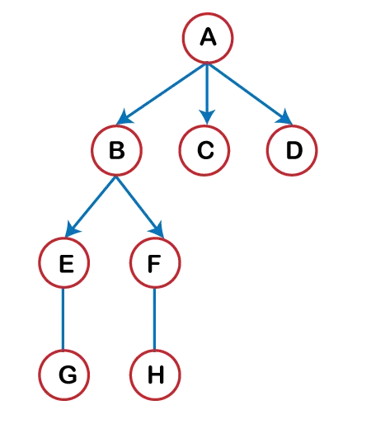
The plan
Try to remove features where data may not be possibly collected in small communities.
Determine easily collectible and most possible features responsible for heart disease.
Test Decision Tree Classifiers to find best features and depth to get best results.
If results are not satisfactory, will switch to Kmeans, and KNN. (Possibly will combine with features obtained from the most accurate Decision tree).
Will create visual aids based on the models created (scatter plots, tree graphs, etc.)

